Slide 1
How will you use your new powers and remain ethical?
Gif thanks to GetYarn

Slide 2
Agenda
What is Ethics?
Moral use of Data Science Superpowers
Immoral use of Data Science Superpowers
Ethical Choices
Considerations
Case Study
Open Discussion
Summary

Slide 3
Announcement
Core assignments are due Friday 9 am
Project

Slide 4
What is Ethics?
Ethics is based on well-founded standards.
Consider your rights, obligations, benefits to society, fairness, or specific virtues.
Issues often include religion, gender, ethnicity, age, political views, and conflicts of interest.

Slide 5

Moral Use of Data Science Superpowers:
You can:
Create ‘intelligent machines’
Predict the future
Diagnose disease
Save time and money
Help countless people
Change lives
Image thanks to The Hollywood Reporter

Slide 6
Immoral use of Data Science Superpowers:
You can also:
Exploit people
Invade privacy
Manipulate public opinion
Perpetuate bias and inequality
Cause direct and indirect harm
Gif thanks to Gifer

Slide 7
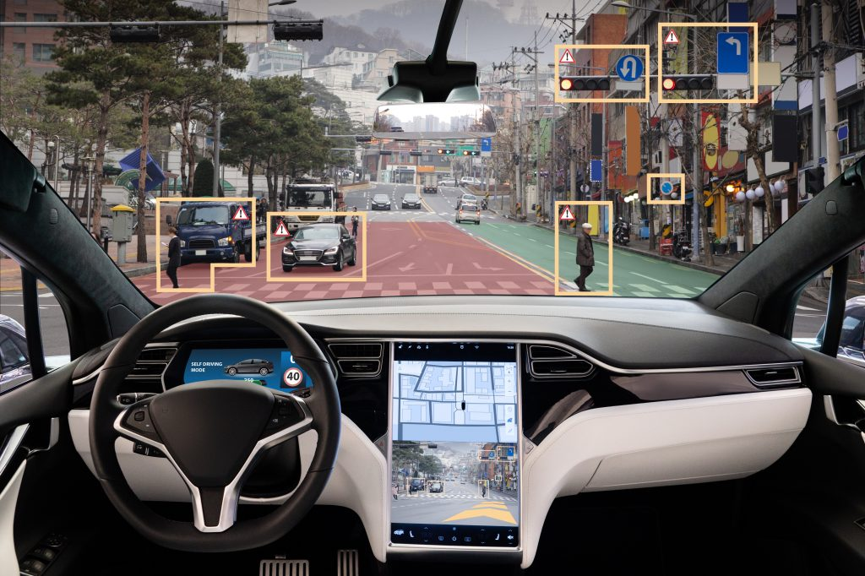
Some ethical choices are very difficult!
Examples:
Self-driving cars
Health Care Systems
Insurance claims
Loan risks
Image thanks to Robotics Business Review

Slide 8
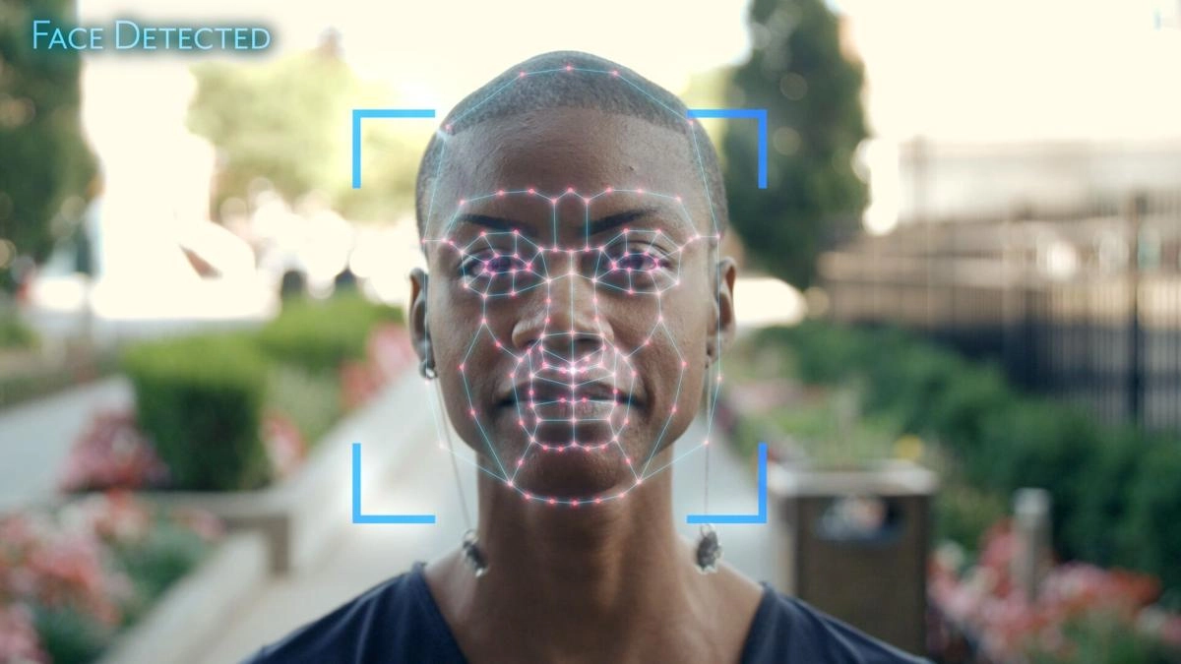
Some choices require consideration
Data gathering and consent
Coded biases
Targeted ads
Other issues to consider?
Image thanks to gal-dem

Slide 9
Case Study Breakout Groups
Breakout groups: 10 Minutes
Discuss the abstract:
Benefits?
Ethical considerations?
Potential problems?
Be ready to share one topic that came up.

Slide 10
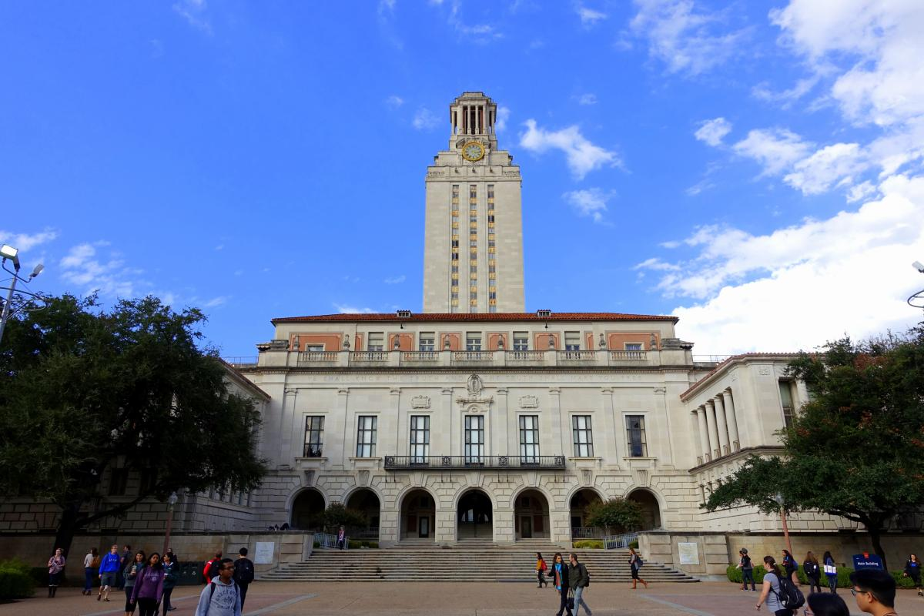
Follow-up Article on GRADE Admissions Algorithm
https://www.insidehighered.com/admissions/article/2020/12/14/u-texas-will-stop-using-controversial-algorithm-evaluate-phd
Time permitting, we will read the above article that discusses some of the ethical problems with the GRADE algorithm. If time does not permit, please read this article on your own when you have time.

Slide 11
Open Discussion:
What other ethical issues do you want yourself and your classmates to consider as you move into the professional world of data science?
In order to guide the conversation, please:
Open This Document
Make a copy
Fill it in during your discussion
If possible, print a copy and place it near your computer

Slide 12
Summary
Your new superpowers in data science can be used for good or bad. I encourage you to proactively and consciously choose good every time.
There are ethical choices we must face when we incorporate models that may be biased.
There are considerations to evaluate when using your abilities in the decision making process.

